Slide 1
Sensory Overload
Tracking Wearable Device
Damian Ortizflores, Alejandro Ibarra, Edin Latic, Lauren Craig

Slide 2
Sensory Overload
-Occurs in people with:
Autism, anxiety, PTSD, sensory processing disorders, etc.
-Prevention assists with:
Focusing, stressful situations, and anxiety attacks
-Sensory overload can affect any of the senses:
Sight, touch, hearing, taste, and smell.

Slide 3
Sensory Overload Prevention
Goals: Predict and alert sensory overload may occur
Intended User: Caretaker or Individual with Autism, anxiety, PTSD, sensory processing disorders, etc.
User Interface: App displays environmental indicators with various ranges of acceptable and potential overload ranges.

Slide 4
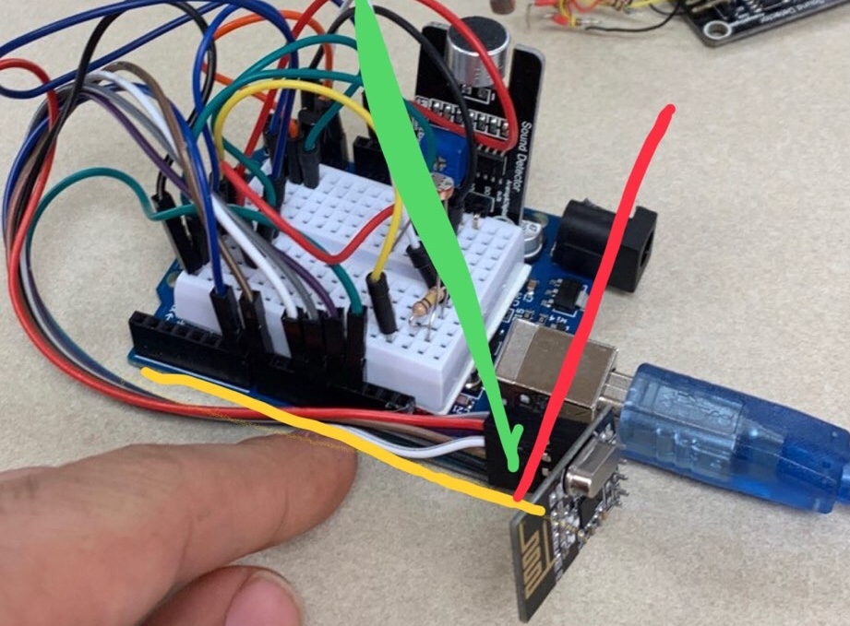
Technology Used
Two Arduino UNOs (One Transceiver and One Receiver)
Two Arduino NRF24L01+ 2.4GHz Wireless RF Transceivers
Sound Detector Microphone
10K Thermistor
Photoresistor
Processing-User Interface Application

Slide 5
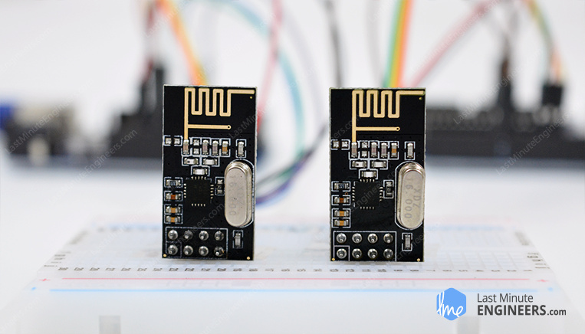

Coding
Utilizing the various sensors described above we send this data to wirelessly to our desktop using our NRF24L01+ 2.4GHz Wireless RF Transceivers

Slide 6
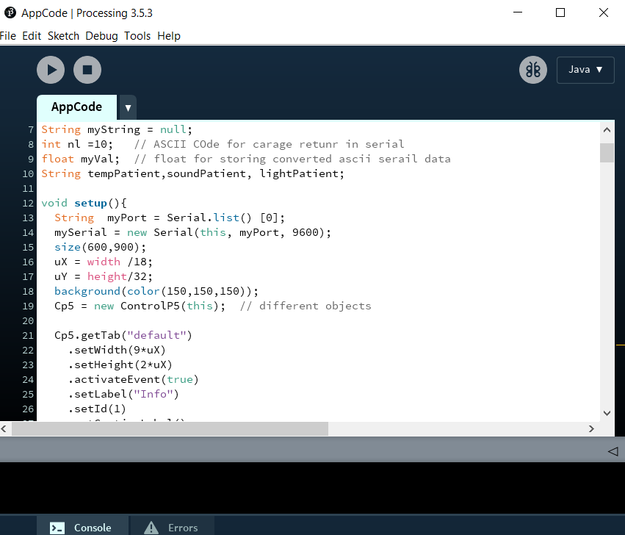
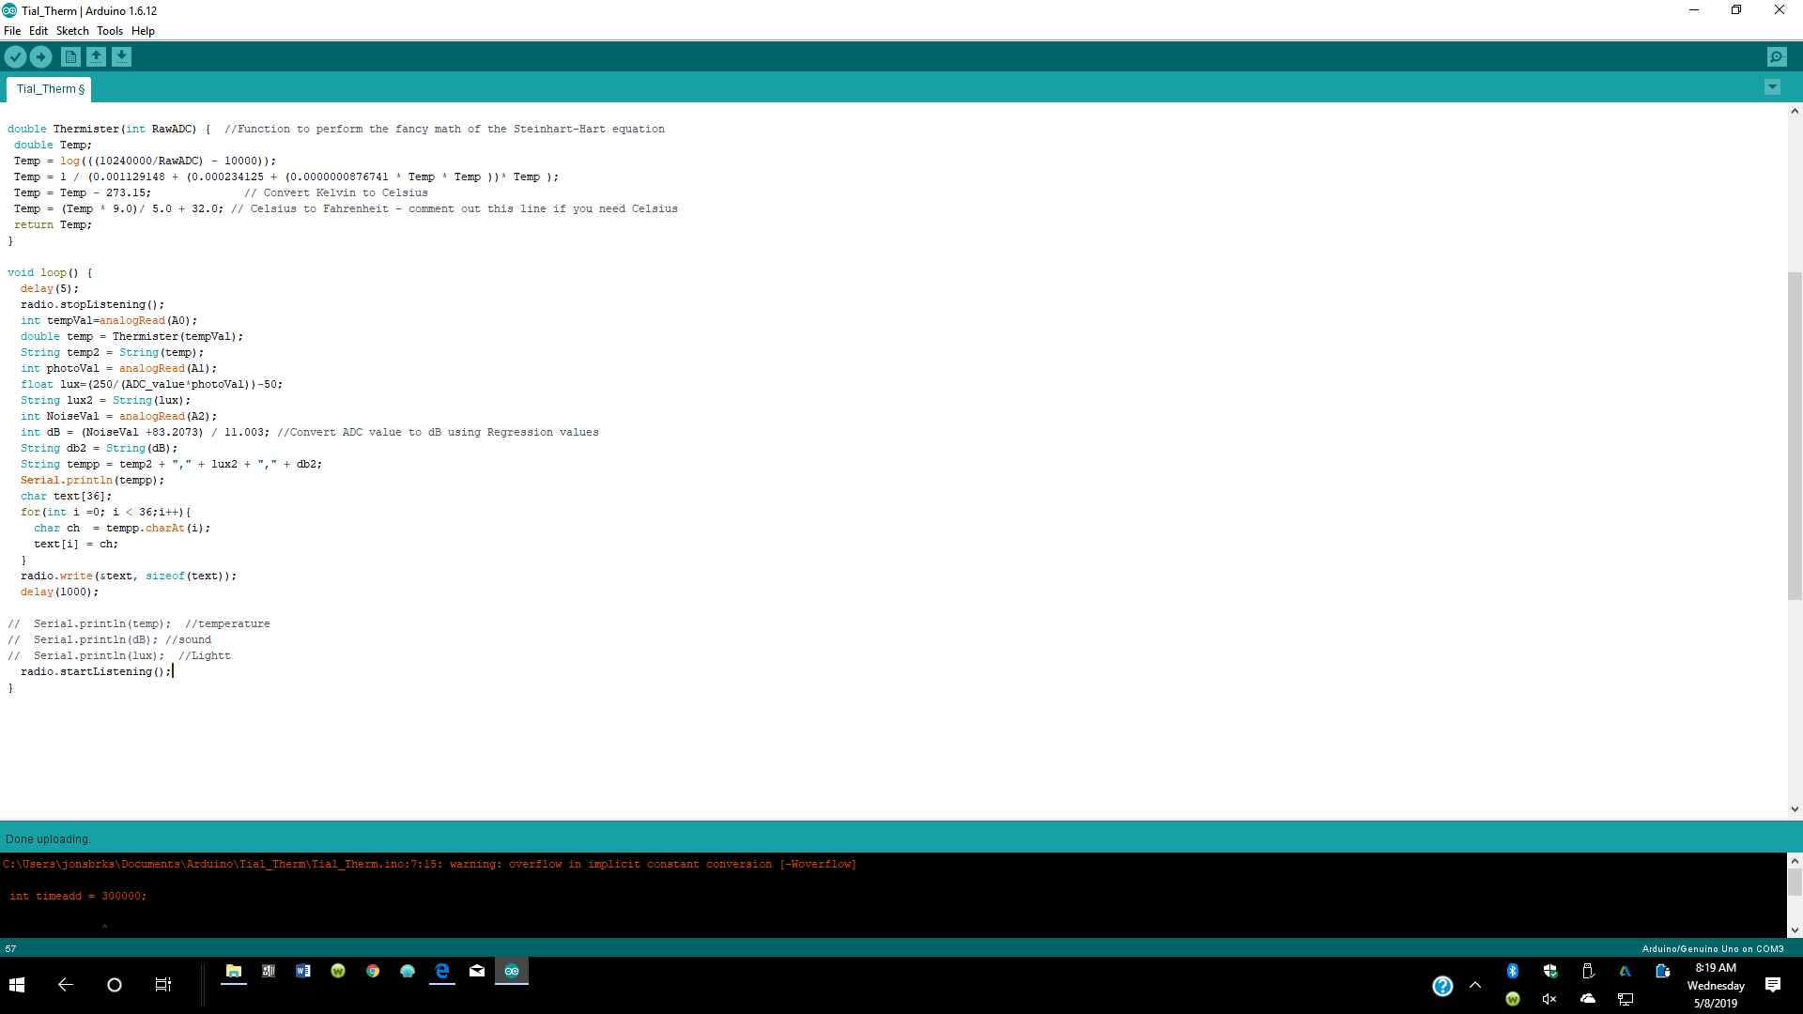
Coding
Receiving this data in out MATLAB script, we send this data continuously to Processing3 to be analysed live in our app for user to see

Slide 7
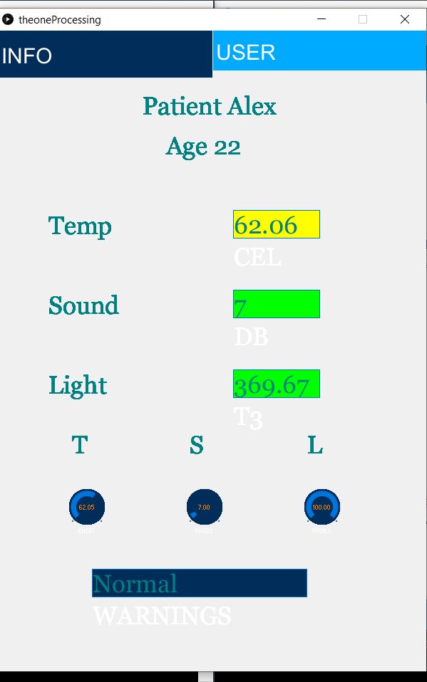
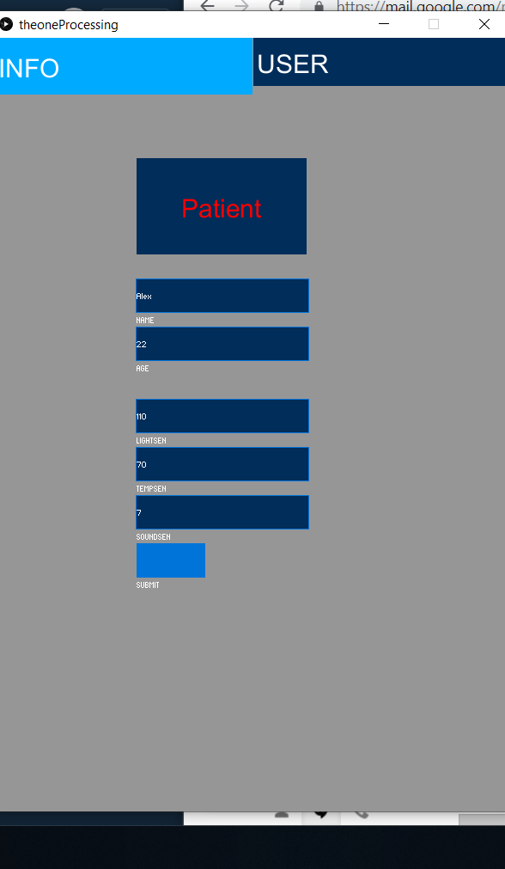
Coding
The patient can set their sensory settings whether it be touch, sound, temperature, or light.
If the readings go out of range The app will give warnings to the user.

Slide 8
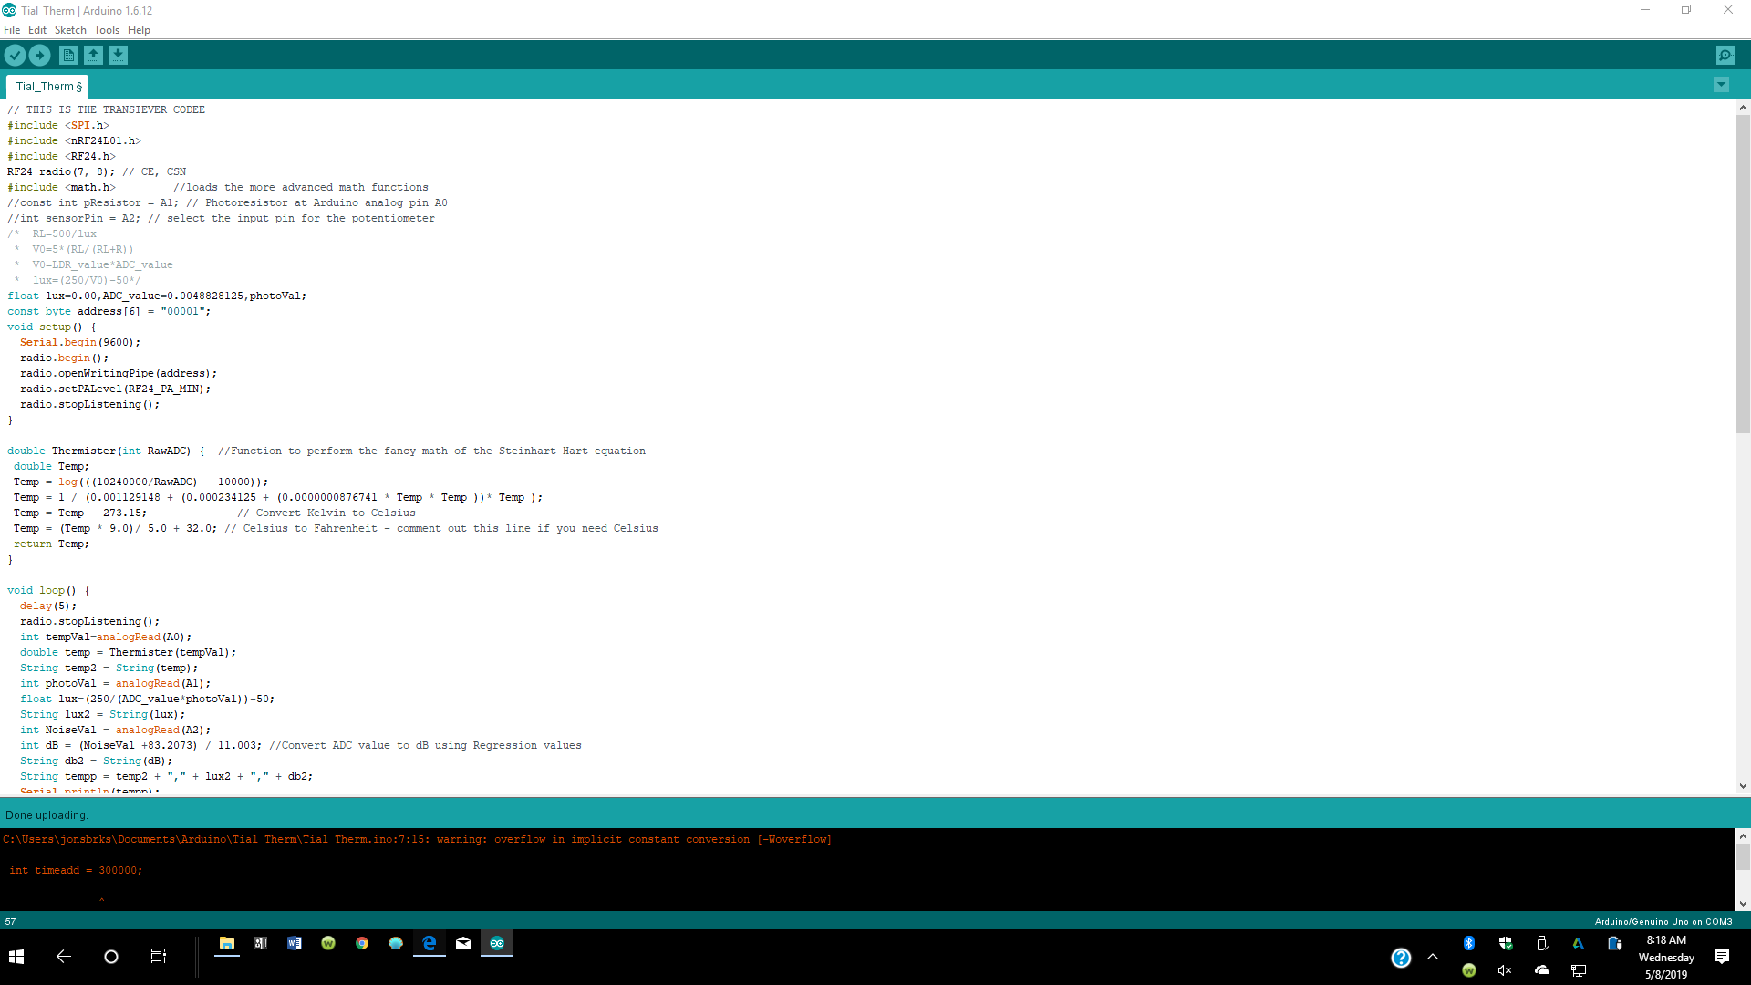
Arduino Code

Slide 9
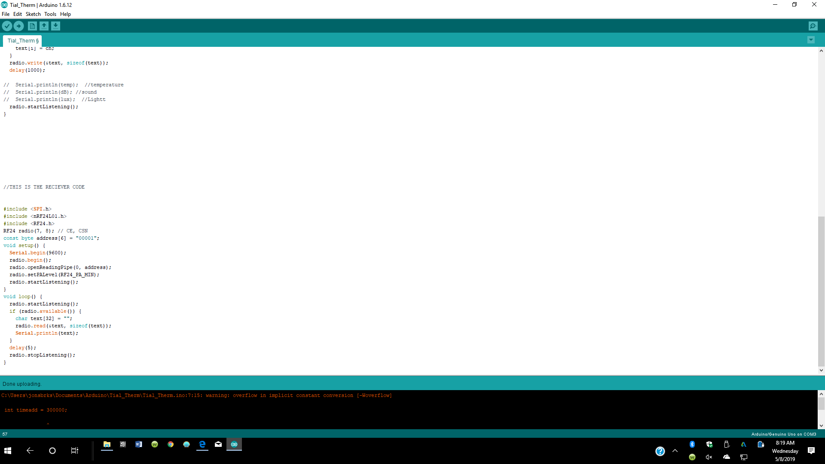
Arduino Code

Slide 10
References
[1] Healthline. “What Is Sensory Overload?” ​Healthline​, Healthline, www.healthline.com/health/sensory-overload#examples.

